Slide 1
European Federation of Foundation Contractors EFFC
June 2017

Slide 2
The Federation of Foundation Contractors
represents companies in 16 European countries.
Members are Specialist Foundation Contractors
which are organised and represented either through
National Federations or by a National Coordinator
representing that country.

Slide 3
Members
Austria
VOEBU, 38
Belgium
ABEF, 17
Czech Rep.
ADSZS, 8
Denmark
3
France
SOFFONS, 35
Germany
HDB, 45
Hungary
AVS, 6
Italy
AIF, 39
Netherlands
NVAF, 68
Poland
PZWFS, 19
Portugal
6
Romania,
6
Spain
AETESS, 6
Sweden
SAFE, 23
Switzerland
Infra, 37
UK
FPS, 19
Total: 16 Federations
appr. 370 Contractors
Note: Member numbers may vary

Slide 4
Mission
Promote the common interest of the Members of the Federation to achieve a high professional standing of Special Foundations in Europe
Objectives
The Mission shall be achieved by:
Improve standards of workmanship, technical competence, safety and innovation
Create and maintain an effective networking amongst the Members of the Federation and with its Stakeholders
Express the point of view of its members with the European Commission, Authorities, Professional Institutions and other Federations and Third Parties

Slide 5
Organisation,Tasks and Duties
Recommend policy, strategy and objectives;
Manage and report the financial situation;
Propose tasks for the future development;
Deal with any matters of urgency between meetings of the EC
and any other matter referred to them by the EC or C;
Officers
Agree the policy, strategy and objectives;
Comment and approve the Budget and Subscriptions;
Initiate, propose and implement tasks for the future development;
Transfer and diseminate the work of EFFC to the NFs;
Executive
Committee
Promote the common interests of its members with the aim of improving standards of workmanship and maintaining high standards of technical competence & safety;
Working
Group
Council
Meeting
Recommend policy, strategy and objectives;
Initiate and propose tasks for the future development;
Manage and report the financial situation;
Election of other Officers;

Slide 6
Presidents
1989 - 1992
1992 - 1994
1994 - 1997
1997 - 1999
1999 - 2001
2001 - 2003
2003 - 2005
2005 - 2007
2007 - 2009
2009 - 2011
2011 - 2013
2013 - 2015
2015 - 2017
2017 - 2019
UK
France
Germany
Italy
Greece
UK
Germany
France
Netherland
Belgium
Italy
UK
Germany
Spain
P. Thornton
J. Benatar
P. Arz
G. Trevisani
G. Matras
D. Sherwood
M. Stocker
P. Runacher
P. De Kort
M. Bottieau
S. Trevisani
C. Primett
H.-J. Bliss

Slide 7
Officers
President:
Hans-Joachim Bliss, BFA (D) Senior Vice President:
Jose Candela, AETESS (ES)
Junior Vice President:
Olivier Peter SOFFONS (F)
Treasurer:
Olivier Peter SOFFONS (F)
Additional Officers
Andrea Acerbi AIF (I)
Andreas Körbler VÖBU (A)
Martin Blower FPS (UK)
Immediate Past President: Chris Primett, FPS (UK)

Slide 8
Working Groups
CEN / TC 288
CEN / TC 341
CEN / TC 104
EN 16228
Technical
Safety Coordination
Checklist Machinery
Risk Assessment
Rig Driver Training
Accident Analysis
Tool Box Talks
HSE
Condition of Specialist Foundation works
JV Contracts
Dispute Resolution
Managing Complex Geotechnical Works
Sustainability / Carbon Calculator
Partnering Contracts / Fair Risk Sharing
Contracts

Slide 9
Technical
EN 1536
Bored PIles
CEN/TC 288
EN 1537
Injection Anchor
EN 1538
Diaphragm Wall
EN 12063
Sheet Pile
EN 12699
Displacement Pile
EN 12715
Injections
EN 12716
Jet Grouting
EN 14199
Micro PIles
EN 14475
Reinforced Earth
EN 14490
Soil Nailing
EN 14679
Deep Soil Mixing
EN 14731
Deep Vibro Densification
EN 25237
Vertical Drain
CEN/TC 104
Concrete
CEN/TC 396
Earth Works
CEN/TC 250
Design
CEN/TC 189
Geosynthetics
CEN/TC 341
Geotechn. Testing
Special Task Groups

Slide 10
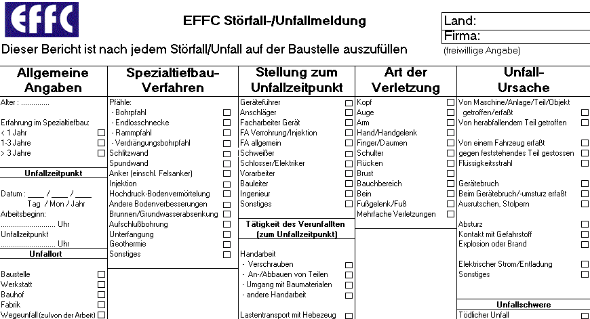
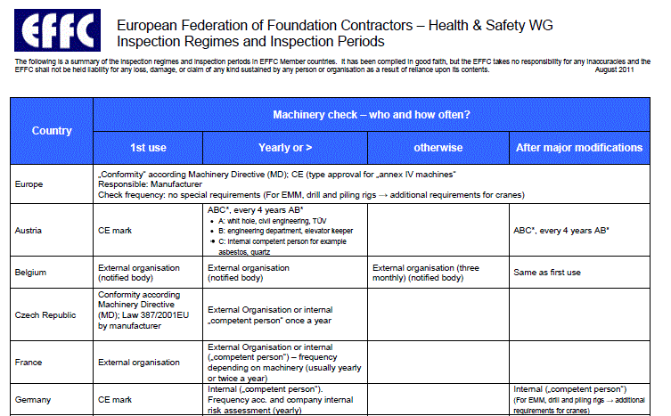
HSE
Health & Safety Charter
Safety Co-ordination
On site risk assessment
Tool Box Talks
Certifyling checking machinery
Rig Driver Training
Analysing Accidents

Slide 11
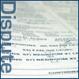
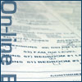
Contracts
 | Special conditions for specialist foundation works EFFC has developed standard conditions to cover the special facilities required for foundation work. These eliminate the need to negotiate terms for each contract - saving time and money for both the foundation contractor and the client.
 | JV contract The European Joint Venture Agreement comprises a standard suite of documents for use where two or more enterprises wish to associate themselves in a Joint Venture.
 | Dispute resolution EFFC's guide to dispute resolution across Europe
 | The use of on-line bidding for foundation contracts EFFC believes that online bidding is not usually a suitable procurement method for foundation contracts. It strongly recommends that anyone considering the use of online bidding takes into account the advice contained in this document.

Slide 12
Code of Conduct
Standards of Behaviour agreed by the EFFC
This statement of Standards of Behaviour has been developed and adopted by the EFFC. Each National Federation or Group is requested to consider and adopt this Standard.
National Federations or Groups are requested to recommend the Statement to their individual corporate Members for adoption, at an individual level in their market place.
Ethics cannot be enforced. A high ethical standard is a target to be aspired to and worked towards in the improvement of our market place.
A. Key values
The company undertakes:
to show integrity towards public and/or private clients
to observe all relevant legislation and regulations
not to participate in price fixing or securing contracts to the disadvantage of the public
to make no payments to clients directly or indirectly related to a contract
to demonstrate honesty and transparency in pricing, in drawing up contracts and in preparing invoices
to reject illegal employment practices
…..
B. Customer satisfaction
The company undertakes to endeavour to ensure:
on-time delivery of contracted services tailored to the customer's needs
honesty and frankness in all phases of construction
…..
C. Job satisfaction
The company undertakes to:
give employee safety top priority on the construction site
provide training to employees at all levels of the company
…..
D. Environmental protection
The company undertakes to:
encourage the development and application of environmentally friendly

Slide 13
Sustainability
The Principles
Consider and promote sustainability in its broad social, economic and environmental context in all aspects of foundation industry related activity.
Environment:
Develop opportunities to make positive contributions to the environment;
Adopt measures and processes to prevent adverse environmental impacts.
Social Responsibility
Promote the elements required for foundation industry stakeholders to engage in productive work, the creation of wealth and a good quality of life for all;
Promote good safety, health and well-being combined with personal development throughout the foundation industry.
The Market
Adopt sound business ethics by embracing and implementing the EFFC 'Standards of Behaviour';
Promote competitive behaviour that is socially and environmentally acceptable.

Slide 14
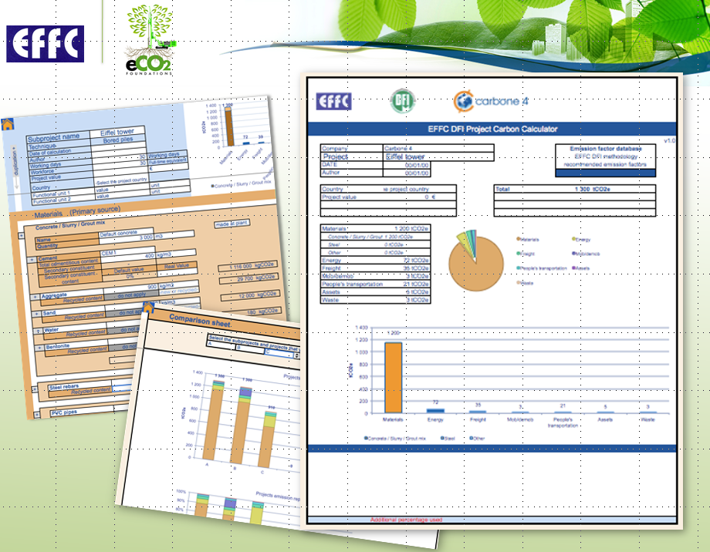
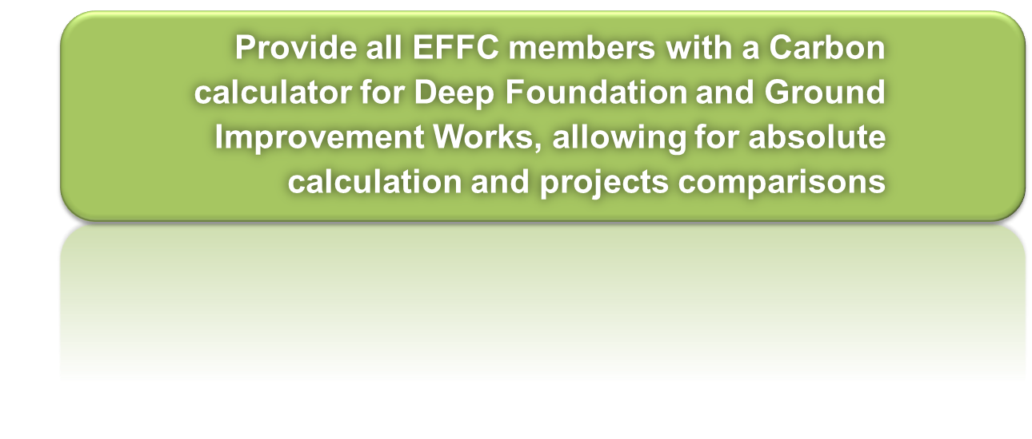
Sustainability
eCO2 Carbon Calculator
The tool allows project comparisons, enabling the user to select the
techniques with the lowest associated emissions and to compare the
performance of different solutions for the same customer need

Slide 15
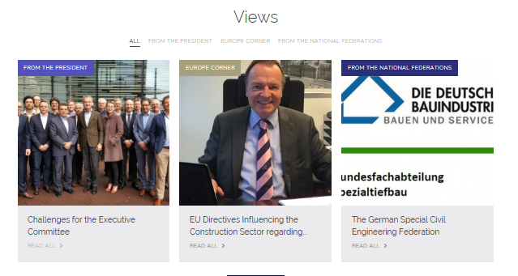
Website: www.effc.org

